Slide 1
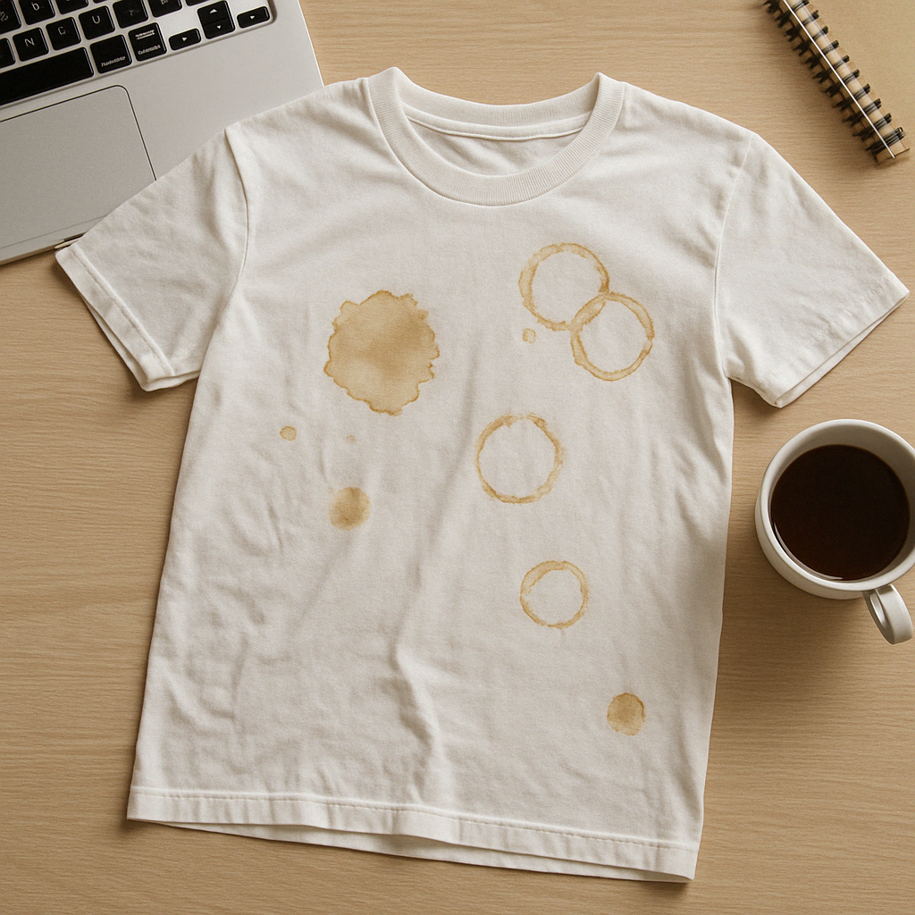
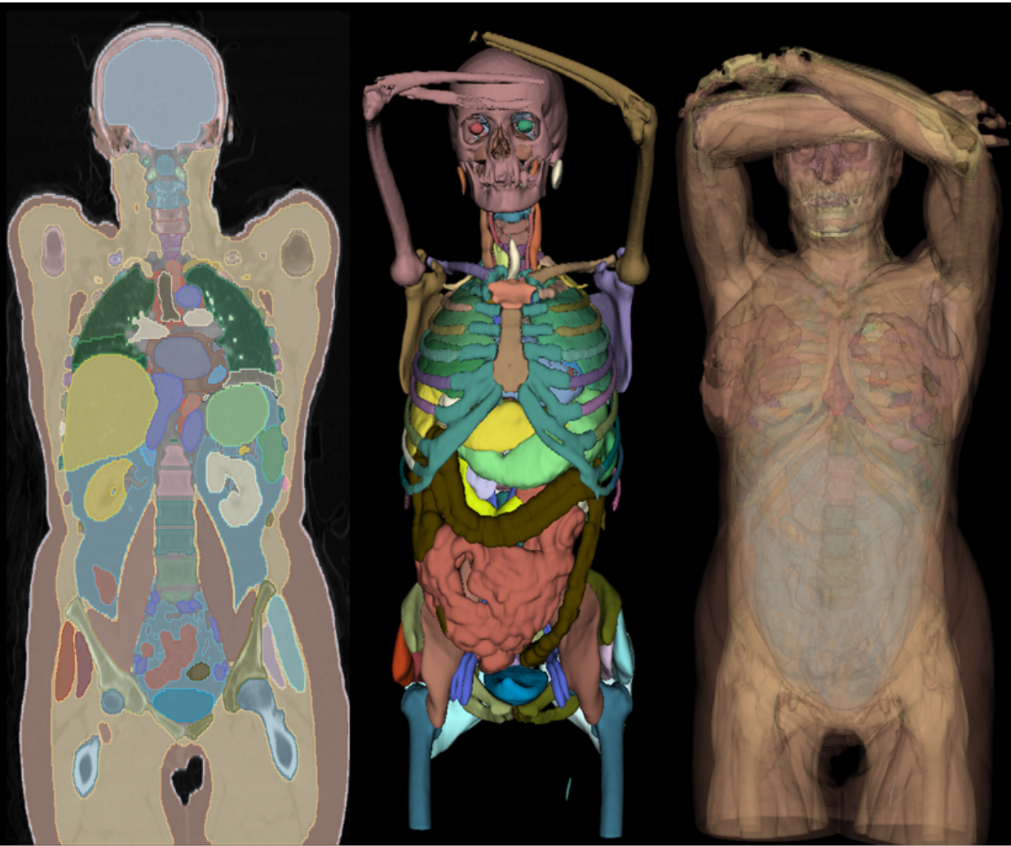
Practical Course: Computer Vision for Human-Computer Interaction
SS 2025
M.Sc. Zdravko Marinov
Institute for Anthropomatics and Robotics, Karlsruhe Institute of Technology (KIT)

Slide 2
What will you learn?
Apply algorithms from lectures and papers
Hands-on experience
Get comfortable with machine learning tools
Learn about current problems and applications in machine learning and vision
Find solutions to difficult problems

Slide 3
Scope of the Practical Course
Research
Implementation

Slide 4
Scope of the Practical Course
Research
Implementation
Literature
research
Reporting the
results in a
4-page paper
Defining the
research quesiton

Slide 5
Scope of the Practical Course
Research
Implementation
Working product
in just
one semester!
Literature
research
Building a
project as a team
(git, time planning)
Reporting the
results in a
4-page paper
Using DL
frameworks
(e.g. PyTorch)
Defining the
research quesiton

Slide 6
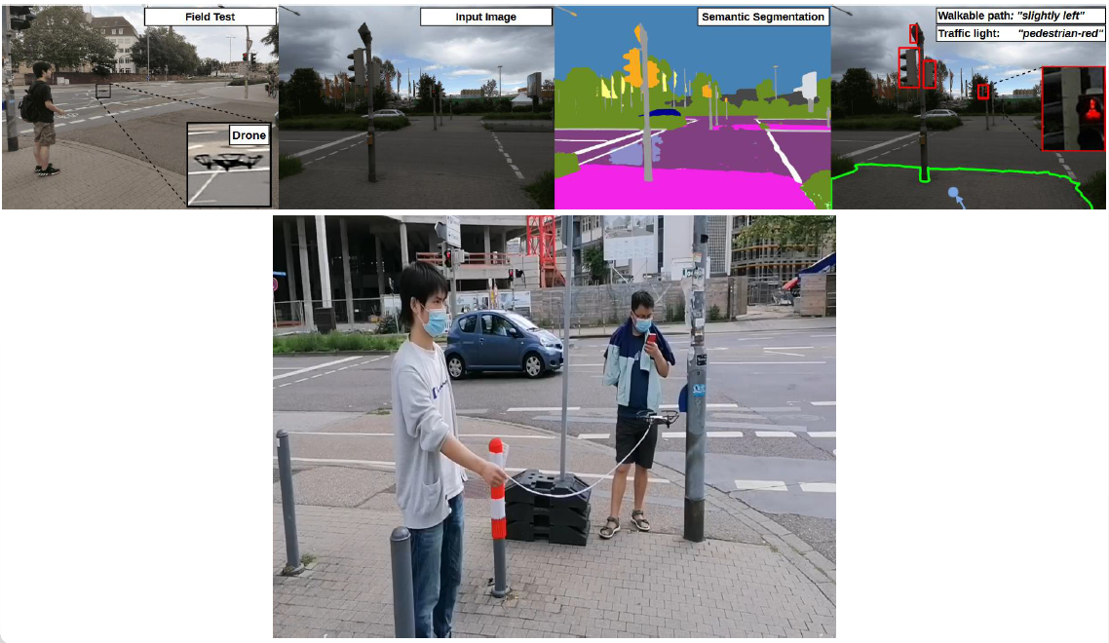
Examples from previous semesters: SS21 – Flying Guide Dog, ROBIO 2021

Slide 7
Examples from previous semesters: SS22 – Interactive PET/CT annotation, ISBI 2023

Slide 8
Examples from previous semesters: SS23 – AR-guided 3D Foot Object Acquisition

Slide 9
General Information
Weekly meeting (MS Teams)
Compulsory Attendance
Talk about intermediate results & problems
Ask for help and guidance
Weekly goal: stay on “track”
2-3 Students per Team
Use version control (e.g. git)
Internal git repos provided via the SCC’s GitLab (https:/git.scc.kit.edu/)
Divide work into separate tasks and distribute within group

Slide 10
At the end of the Practical Course…
Final presentation of each group (1/3 grading)
15 minute talk per group
The presentation should be about:
Goals and usefulness of your topic
Your proposed approach
Results
Written report describing the topic/approach/results (1/3 grading)
4-pages in standard paper format
Abstract/Introduction/Method/Results/Conclusion
References do not count in the 4-pages!
Written in a conference template
Working implementations of your algorithms (1/3 grading)
A Readme-file describing how the code can be used to reproduce the results
If the team agrees → make code publicly available to the community

Slide 11
Topics SS 2025
A: CleanSight: Building an iOS Stain‑Detection Assistant for People Who Are Blind
B: Agentic AI Tool For Automatic Document Processing
C: Chat with your PET
D: Outdoor Navigation with Meta Aria Smart Glasses for Visually Impaired People
E: Accessible Tool for Paper Form Filling
F: Exploring Coding Agents to improve Usability of iOS applications for Blind Users

Slide 12
TOPIC A
Supervisors:
Ruiping Liu (ruiping.liu@kit.edu)

Slide 13
Topic A: CleanSight: Building an iOS Stain‑Detection Assistant for People Who Are Blind
Tasks:
Collect a diverse set of photos of clean and intentionally stained clothes
Under different lighting, fabrics, and backgrounds…
Annotate each image with stain type and location (bounding box)
Model training (detection and/or classification)
Prototype lightweight networks (e.g., YOLO‑Nano for detection or MobileNet‑V3 for classification)
Evaluate with precision/recall and mAP to find the best trade‑off between accuracy and size
Best model: quantization‑aware training and pruning so the model stays under roughly 15 MB and runs efficiently on mobile hardware
iOS deployment
Convert the compressed model to Core ML, wrap it in Apple’s Vision framework, and build a SwiftUI interface that streams the camera feed while returning real‑time stain alerts through VoiceOver and optional haptics
Profile with Xcode Instruments to keep latency low, add a cloud‑inference fallback for older devices, and finish with accessibility‑focused beta testing before submitting to the App Store

Slide 14
Topic A: CleanSight: Building an iOS Stain‑Detection Assistant for People Who Are Blind
Resources
[1] Hacking, Switching, Combining: Understanding and Supporting DIY Assistive Technology Design by Blind People (CHI 2023) [pdf]
[2] Extracting Clothing Features for Blind People Using Image Processing and Machine Learning Techniques: First Insights (VipIMAGE 2019) [pdf]
[3] Blind People: Clothing Category Classification and Stain Detection Using Transfer Learning (Applied Science 2023) [pdf]

Slide 15
TOPIC B
Supervisors:
Yufan Chen (yufan.chen@kit.edu)
Omar Moured (omar.moured@kit.edu)

Slide 16
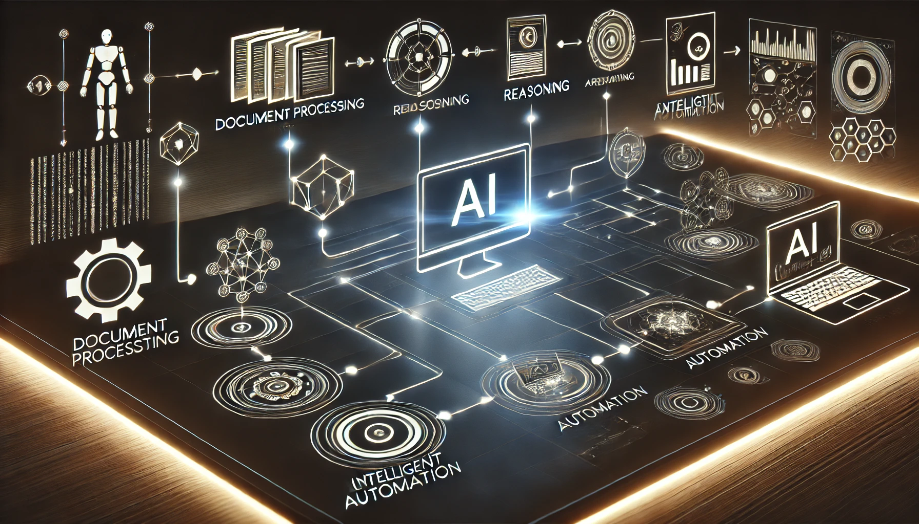
Topic B: Agentic AI Tool For Automatic Document Processing
Tasks:
GUI-Based Document Search & Handling (OmniTool + OmniParserV2)
Set up OmniTool and OmniParserV2 to open documents of various formats (PDF, Word, Excel, images) and parse the file explorer windows into structured information (file names, icons, positions).
Multi-Modal Document Parsing
Use MDocAgent to parse textual and visual elements of documents
Text: OCR and layout parsing
Images: Categorize in figures, charts, signatures
Multi-Agent Coordination for Reasoning and Verification
Implement a pipeline with MDocAgent’s five specialized agents (General, Critical, Text, Image, and Summarizing), tailored for document workflows
Critical Agent: flag discrepancies between text-based extraction and visual-based extraction.
Summarizing Agent: merge all findings into a final answer
Action Execution & Multi-Modal Output
Output final results as text summaries, structured data, or visual representations.
Evaluation of Final output for classical Document Processing Benchmark with and without GUI-Based Document Search & Handling part

Slide 17
Topic B: Agentic AI Tool For Automatic Document Processing
Resources
MDocAgent: A Multi-Modal Multi-Agent Framework for Document Understanding [pdf] [github]
React: Synergizing reasoning and acting in language models [pdf]
OmniParser for Pure Vision Based GUI Agent [pdf] [github]
Retrieval-Augmented Generation for Knowledge-Intensive NLP Tasks [pdf]
HuggingGPT: Solving AI Tasks with ChatGPT and its Friends in Hugging Face [pdf][github]
AutoGPT: Build, Deploy, and Run AI Agents [github]
LangChain [github]
OpenAdapt [github]

Slide 18
TOPIC C
Supervisors:
Alexander Jaus (alexander.jaus@kit.edu)

Slide 19
Topic C: Chat with your PET
Tasks
Identify suitable datasets and target diseases amenable to diagnosis via segmentation-based measurements.
Review and familiarize with agentic AI frameworks in MONAI, focusing on LLM-based pipelines.
Implement prototype agents integrating segmentation models and medical reasoning.
Evaluate prototypes on selected datasets and refine based on diagnostic performance.
Source: https://autopet-iv.grand-challenge.org/
Source: Jaus, Alexander, et al. "Towards unifying anatomy segmentation:
automated generation of a full-body ct dataset via knowledge aggregation
and anatomical guidelines.“ ICIP 2024

Slide 20
Topic C: Chat with your PET
Datasets:
AutoPet Dataset: Gatidis, Sergios, et al. "A whole-body fdg-pet/ct dataset with manually annotated tumor lesions." Scientific Data 9.1 (2022): 601.
Menze, B. H., Jakab, A., Bauer, S., Kalpathy-Cramer, J., Farahani, K., Kirby, J., ... & Van Leemput, K. (2014). The multimodal brain tumor image segmentation benchmark (BRATS). IEEE transactions on medical imaging, 34(10), 1993-2024.
Related work:
Hoopes, A., Butoi, V. I., Guttag, J. V., & Dalca, A. V. (2024). Voxelprompt: A vision-language agent for grounded medical image analysis. arXiv preprint arXiv:2410.08397.
Lin, J., Yin, H., Ping, W., Molchanov, P., Shoeybi, M., & Han, S. (2024). Vila: On pre-training for visual language models. In Proceedings of the IEEE/CVF conference on computer vision and pattern recognition (pp. 26689-26699).

Slide 21
TOPIC D
Supervisors:
Junwei Zheng (junwei.zheng@kit.edu)

Slide 22
Topic D: Outdoor Navigation with Meta Aria Smart Glasses for Visually Impaired People
Tasks
Implement outdoor navigation algorithm using OSM and Meta Aria glasses
Implement path planning algorithm focusing on accessibility and preferences of visually impaired people (Meta Aria glasses can provide GPS and IMU signal)
Deploy real-time segmentation model on LattePanda 3 Delta development board
Use a real-time semantic segmentation model to detect sidewalk and keep blind people safely on the sidewalk during outdoor navigation
Obstacle avoidance (Optional)
Obstacle avoidance using real-time object detection model YoloWorld

Slide 23
Topic D: Outdoor Navigation with Meta Aria Smart Glasses for Visually Impaired People
References
PIDNet: https://github.com/XuJiacong/PIDNet
Meta Aria Glasses: https://facebookresearch.github.io/projectaria_tools/docs/intro
OSMnx: https://osmnx.readthedocs.io/en/stable/
NetworkX: https://networkx.org/documentation/stable/

Slide 24
TOPIC E
Supervisors:
Omar Moured (omar.moured@kit.edu)
Yufan Chen (yufan.chen@kit.edu)
Ruiping Liu (ruiping.liu@kit.edu)

Slide 25
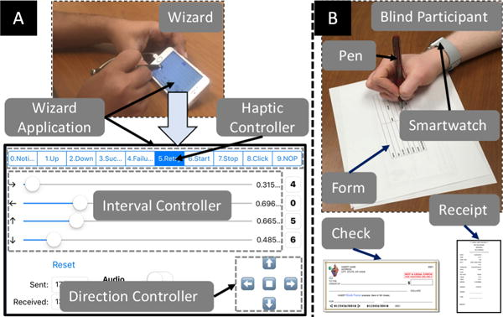
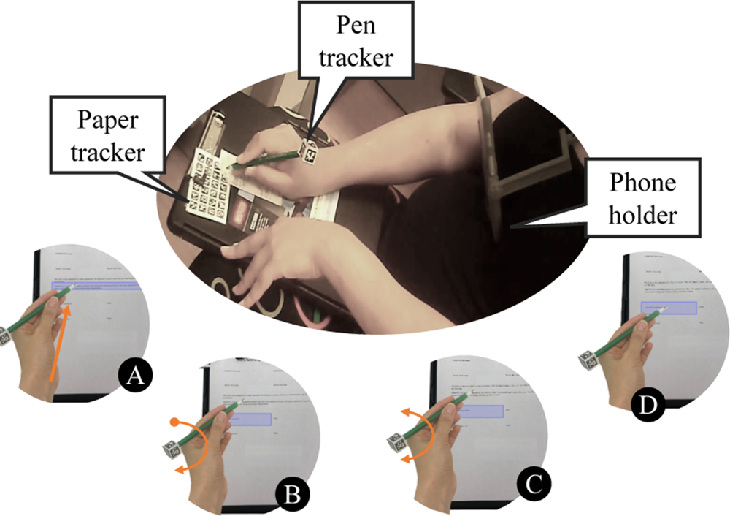
Topic E: Accessible Tool for Paper Form Filling
Tasks
Paper Form Detection
Accurate recognition of fields and labels
Create an accessible listing of the form structure, ensuring each field is identified and labelled for easy navigation.
Guidance System Design through Pinpoint interaction
Guidance through pinpoint delivers real-time cues so users can align their pen or finger with the correct form field, ensuring they physically write in the right location.
Continuous audio cues can steer the pen, while vibrations offer discreet, real-time nudges in the desired direction.
It helps users navigate faster to the start position, making truly independent form-filling feasible.
Dynamic Pattern System Design based on detection results
Dynamic pattern automatically adapts to highlight only the fields that require input, using either mechanical guidance or automated cues.
This approach ensures that the user’s attention is focused solely on each relevant area, enabling a more efficient and accessible form-filling process.

Slide 26
Topic E: Outdoor Navigation with Meta Aria Smart Glasses for Visually Impaired People
References
Write-it-Yourself with the Aid of Smartwatches: A Wizard-of-Oz Experiment with Blind People [pdf]
Towards enabling blind people to independently write on printed forms [pdf]
Take My Hand: Automated Hand-Based Spatial Guidance for the Visually Impaired [pdf]

Slide 27
TOPIC F
Supervisors:
Jiaming Zhang (jiaming.zhang@kit.edu)

Slide 28
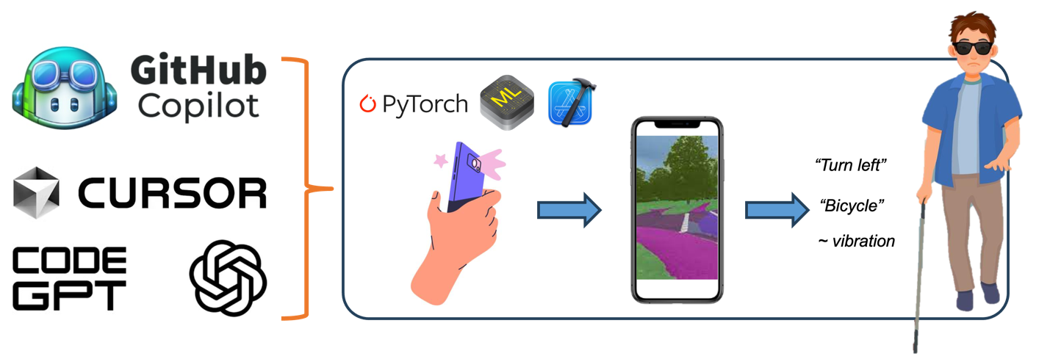
Topic F: Exploring Coding Agents to improve Usability of iOS applications for Blind Users
Tasks
Vision-Based Mobile App with AI Agents:
Develop a basic iOS app that can perform vision-based functions (e.g., real-time object recognition, object search, path following) by using AI agents (Github colilot, Cursor, ChatGPT, CodeGPT, etc).
Usability Improvement with AI Agents:
Improve user interface based on accessibility design guidelines (e.g., screen reader support), and the input/output, like haptic or audio feedback, context-sensitive instructions, etc.
User Testing with Blind/Low Vision Participants:
Design and conduct a usability study with 2–3 blind or low vision users

Slide 29
Topic F: Exploring Coding Agents to improve Usability of iOS applications for Blind Users
Datasets:
COCO, LVIS, etc for object recognition or segmentation
Related work:
Seeing AI: https://www.seeingai.com/
Be My Eyes: https://www.bemyeyes.com/
Envision: https://www.letsenvision.com/app

Slide 30
Topic Selection
Find a team of three people (i.e. through the MS-Teams chat)
Each team sends us a ranking of the presented topics until 4th 23:59 of May per Email at zdravko.marinov@kit.edu (1 – most preferred; 6 – least preferred)
Example: A2, B4, C1, D3, E5, F6
Late e-mails lead to exclusion of the practical course
If you cannot find a team, you can also send personal preferences
Students will be assigned to the respective topics based on their preferences and the order of registration

Slide 31
Organization
Meeting schedule (Potential process)
Week 0 [28.04.25]: Introduction and topic selection
Week 1: Read related work and present ideas on how to approach the problem
Week 2: Implementation
…
Week 15 [28.07.25] (Monday 14:00-16:00): Final Presentations
Weekly meeting for discussion and status updates with corresponding supervisor
Set a consistent date for weekly meetings
Register Projektpraktikum with KIT’s Studienbüro (Modulhandbuch M-INFO-102966, Teilleistung T-INFO 105943)
Deadline: 11.05.2025
If you are not registered by the deadline, you are not considered for the course!
For these slides, other information, announcements and updates → check website [coursemember/321meins] and MS Teams

